Slide 1

BCDE 211 Best Programming Practices (Web & Mobile Development) Assessment-3
Portfolio Presentation
Campus Event Planner
Sunil Kafley
Ara Institute of Canterbury

Slide 2
Project Title: Fruit Finder
Responsive Interactive Web-enabled Map Application
The community utility designed for ethical urban foraging in Christchurch City.

Slide 3
Project Goal
Interactive and Responsive map enabled web application
Helps users find fruit trees through intuitive map interface
Combines mapping, navigation, multimedia and responsive design.
Provide user-friendly experience and usability
Single Page Application
Utilize Design Thinking Approach

Slide 4
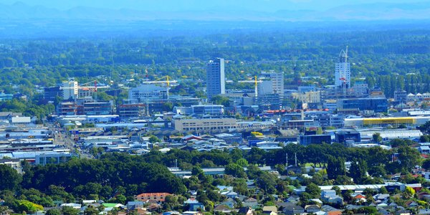
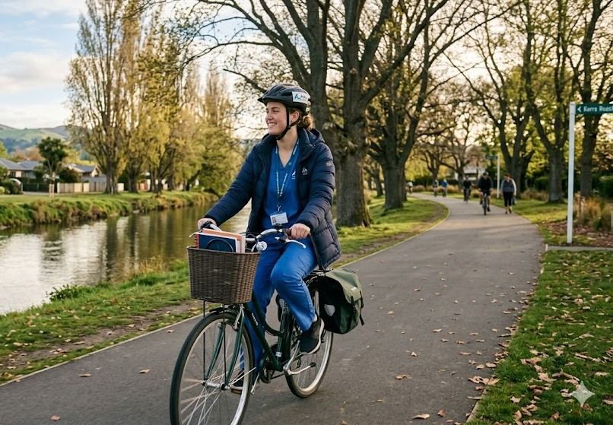
Target Audience
New Zealand citizens, Residents
Christchurch Community Members
Visitors and General Public
Local and International Explorers

Slide 5
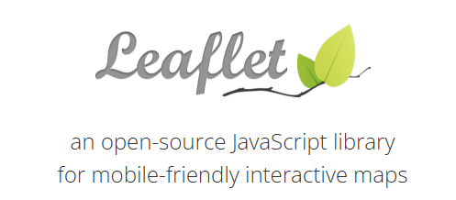

Development Environment
HTML, CSS, JavaScript
Leaflet Mapping Library
Visual Studio Code
Iterative & Incremental
GitHub Version Control
Deployed to GitHub Pages
FIGMA (Low-Fidelity, Medium-Fidelity and High Fidelity Prototypes)

Slide 6
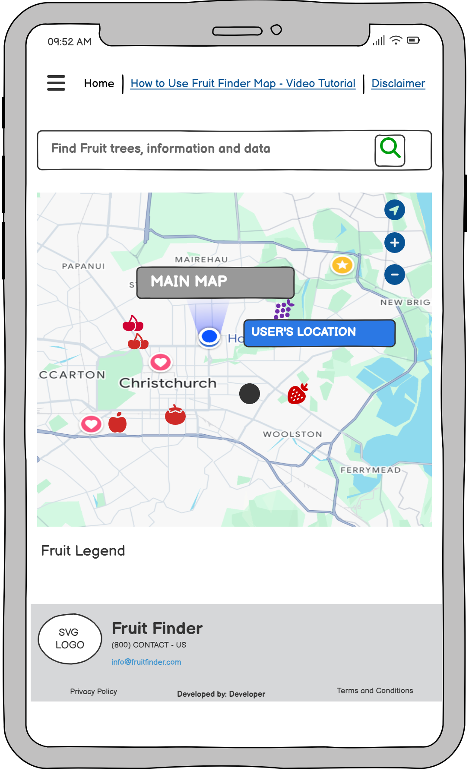
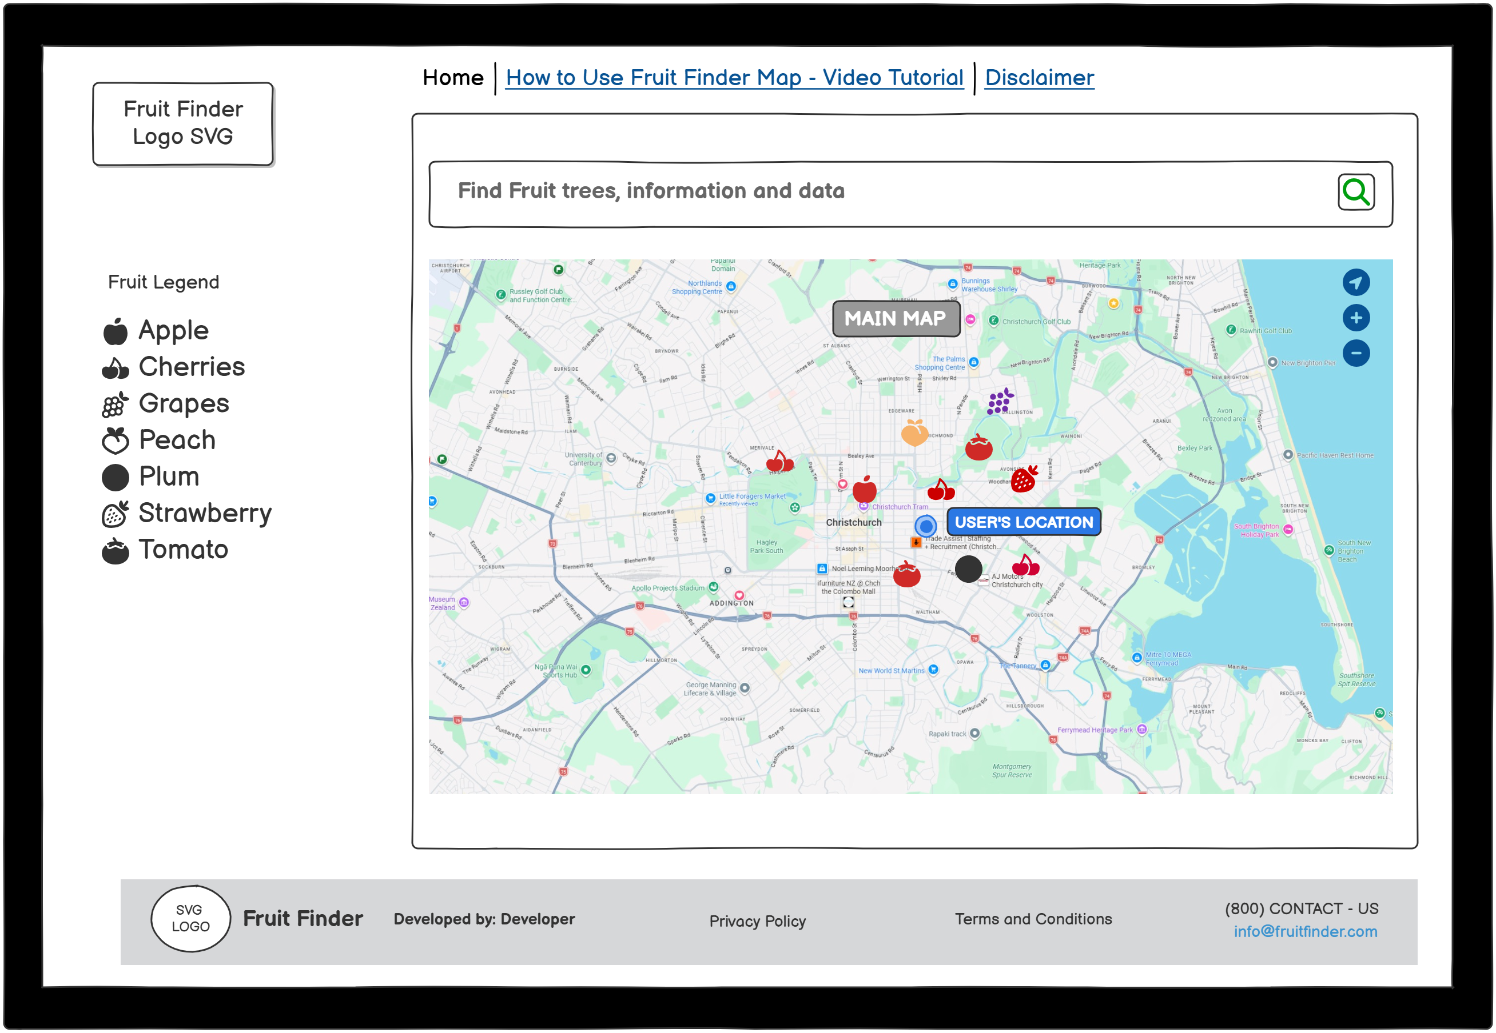
LOW-FIDELITY PROTOTYPE
Wireframe Low-Fidelity-Mobile
Created on Balsamiq
Wireframe Low-Fidelity- Laptop
Created on Balsamiq

Slide 7
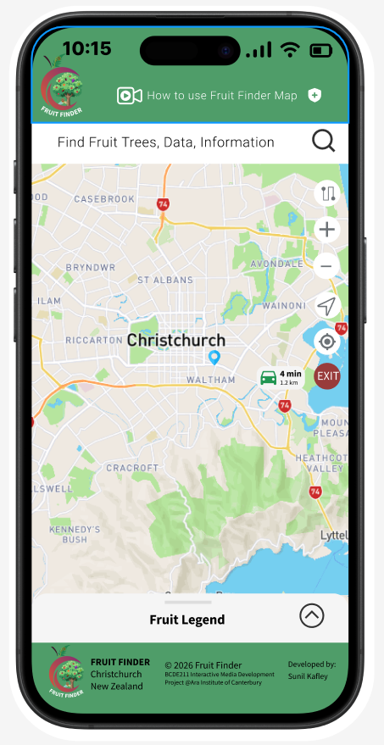
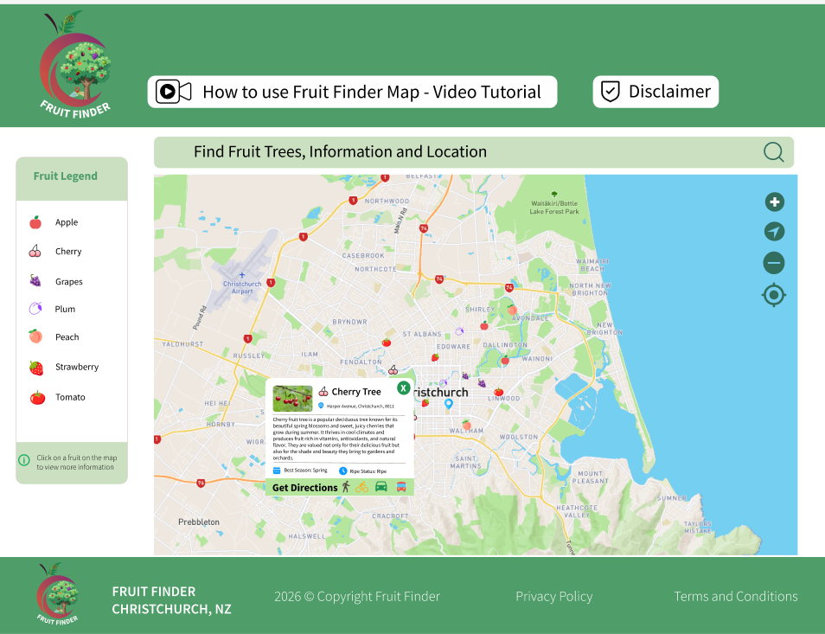
MEDIUM-FIDELITY PROTOTYPE
Medium- Fidelity Laptop
Created on FIGMA
Medium-Fidelity-Mobile
Created on FIGMA

Slide 8
Constraints
Responsive Design Requirements
Time, Cost and Quality
Mobile Screen Space Limitations
Performance and usability considerations
Lack of Premium Features in Free Software Products
(FIGMA, OSRM Demo Server )
Features Enhancement (Travel Modes)
Difficult to integrate Public Vehicle Route

Slide 9
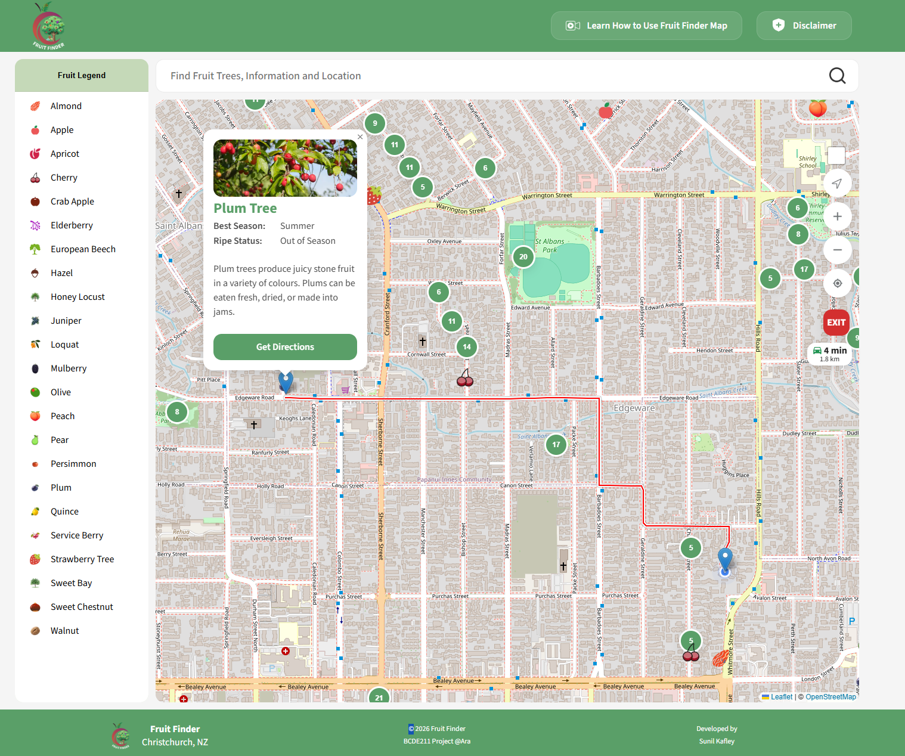
Features
Interactive Map Application
Responsive Layout
Fruit Clusters
Location Markers and Pop Ups
Route and Navigation Tools
Onboarding Experience
Privacy and Disclaimer Page
How to Use Fruit Finder Map
Inclusivity, Accessibility

Slide 10
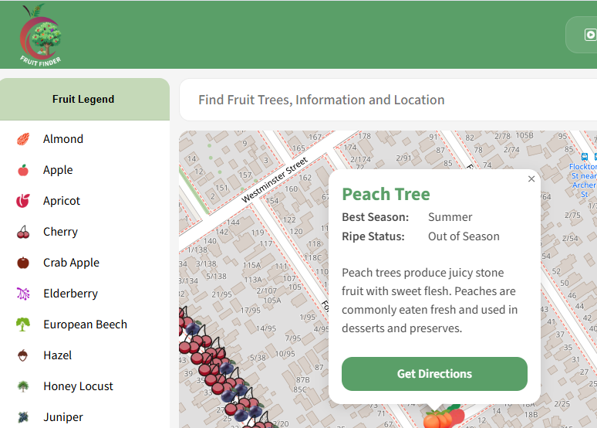
Media Elements- TEXT
Inspired by Christchurch’s Garden City Identity
Nature-focused green color palette
Typography
Primary font: Source Sans 3
Colors
High Contrast color combinations, Tokenized Design System
Font Size
H1 Headings, CSS Rem Units for Accessibility

Slide 11


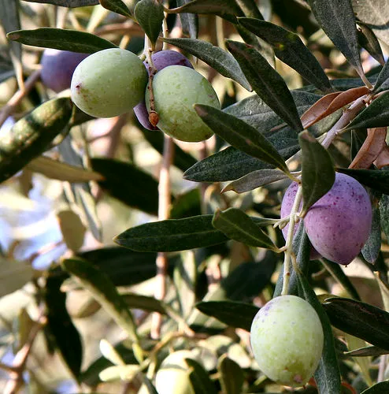






Media Elements- Graphics, Images, Animation
Fruit Icons & Map Markers - .WebP Image Format
Scalable without losing quality and faster loading
Small File Size for mobile users
Pop Up Cards , Map Controls
Animations
Smooth map interactions and transitions
Animated Pulse User location marker
Expandable bottom sheet interactions
Hover and button effects
Map Controls
Pop Up Card
Fruit Icons

Slide 12
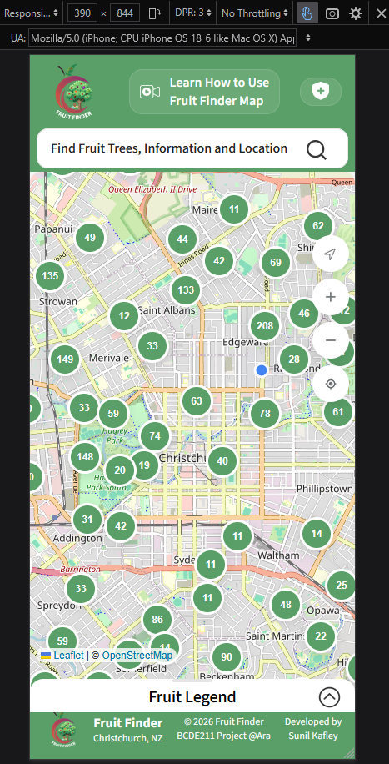
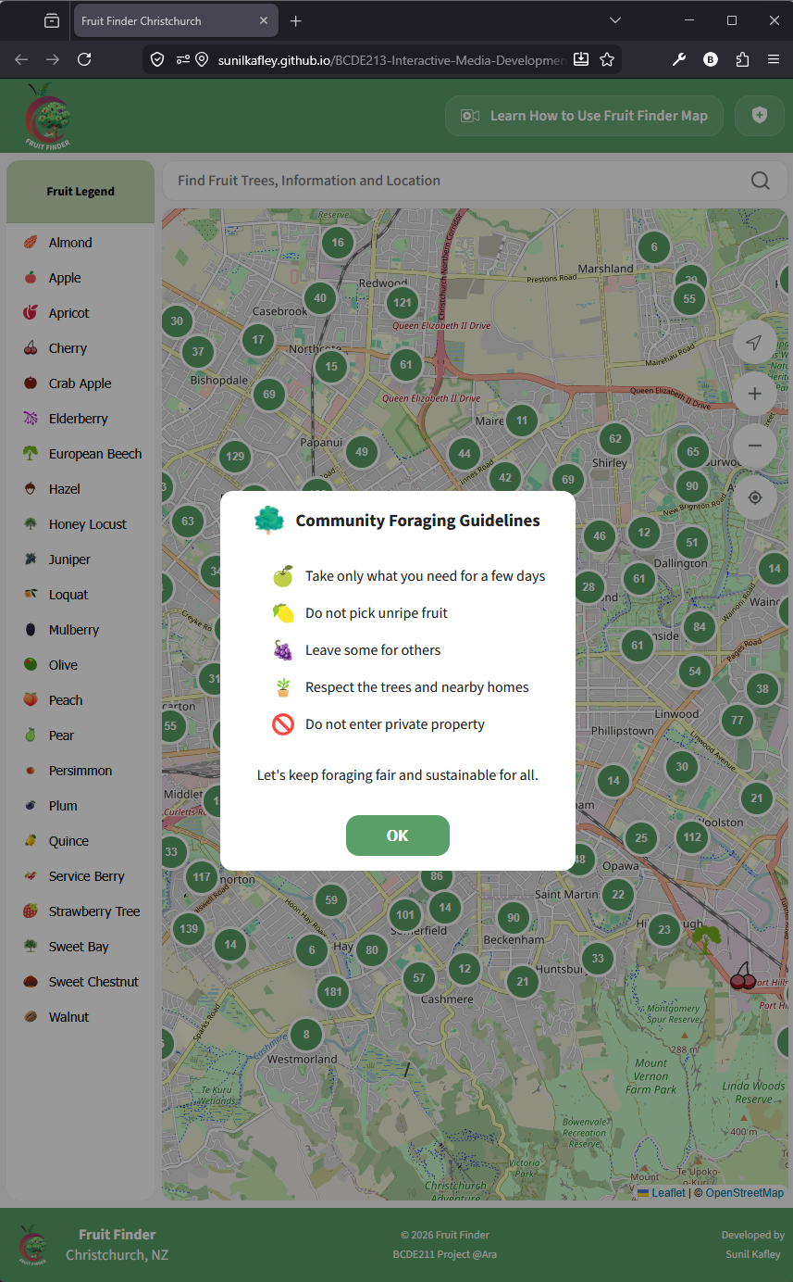
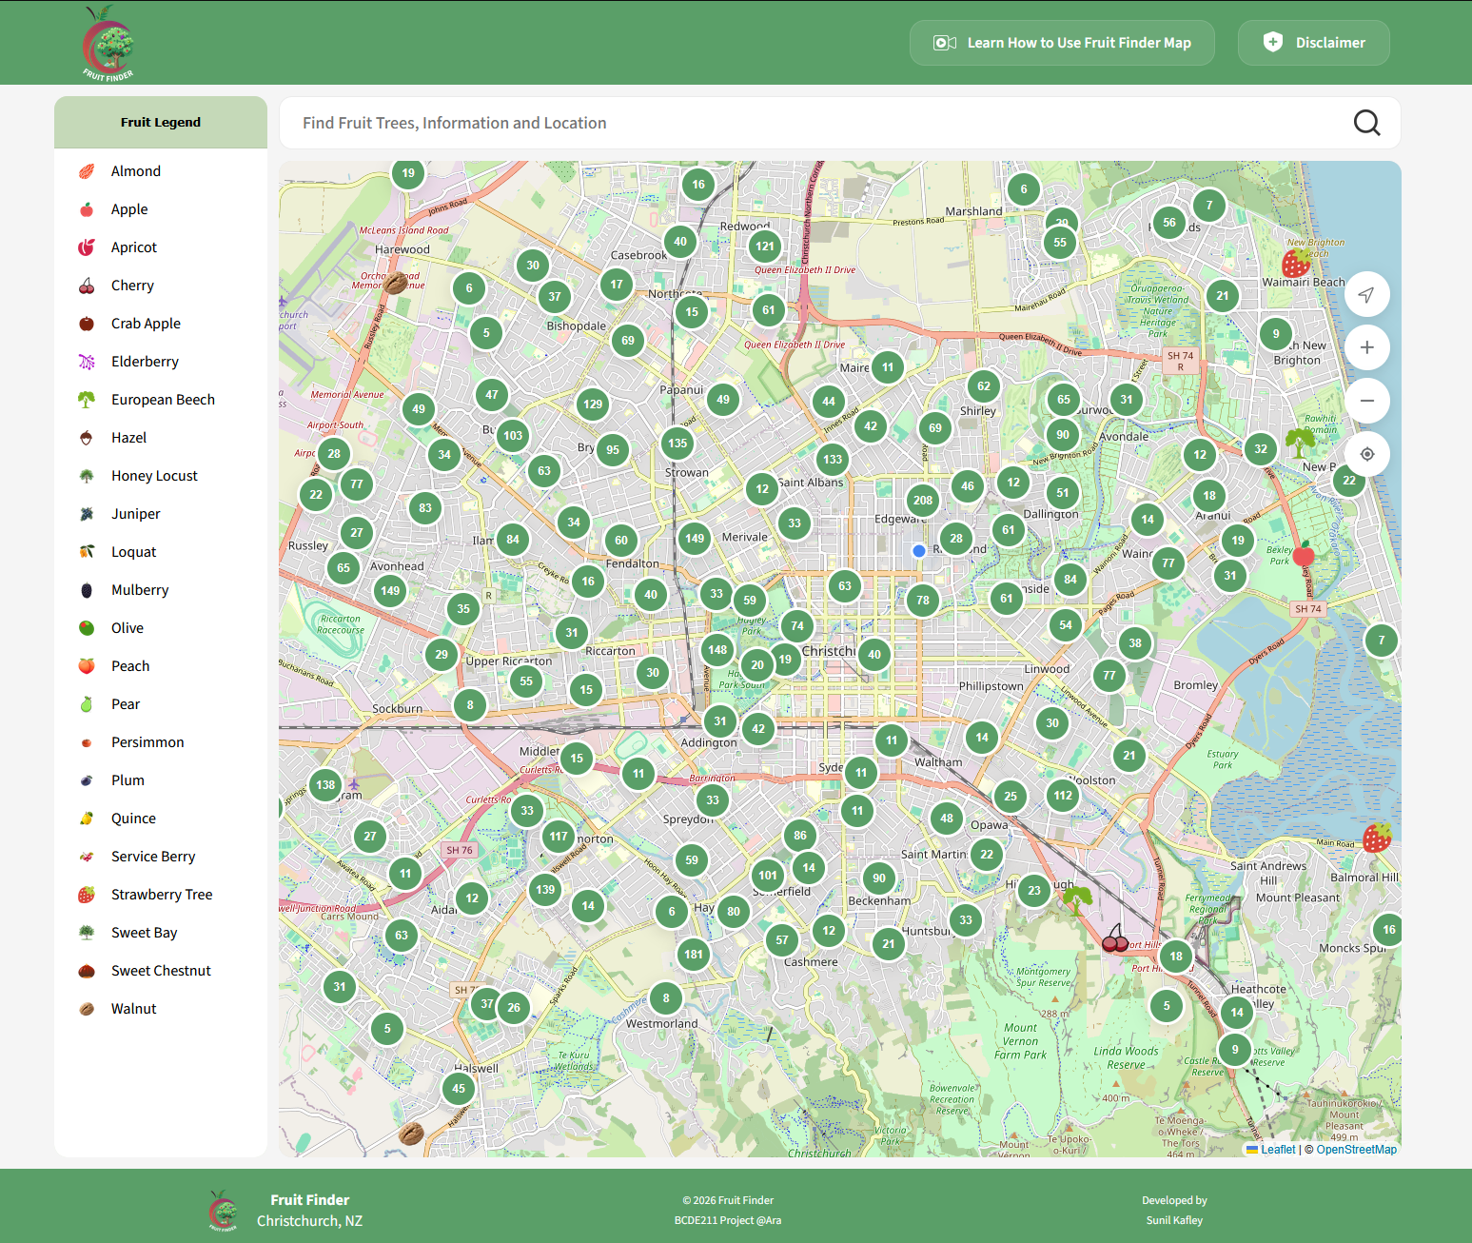
Responsive Layout
Fruit Finder on
Tablet
Fruit Finder on
Laptop/Desktop
Fruit Finder on
iPhone 13 Pro

Slide 13
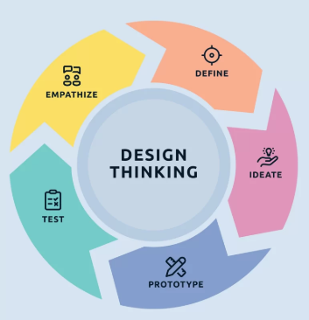
Why These Design Choices ?
Easy to use for all kinds of users
Clear Navigation and Accessibility
Mobile-first Approach
Consistent Visual Design
Improved User Engagement
Resources Consumption (Mobile Data)

Slide 14
Live Demo
https://sunilkafley.github.io/BCDE213-Interactive-Media-Development/

Slide 15
Questions & Feedback
Thank You

